Slide 1
Team Name: Caffe-19
Project: Fake News Detector
Team Members: Akansha Joshi (akansha_joshi45@optum.com)
Prashasti Srivastava (prashasti.srivastava@optum.com)
Himangi Bansal (himangi_10@optum.com)
Kashish Mehta (kashish_mehta@optum.com)
Sindhura Nadella (sindhura.nadella1@optum.com)
WIT Hackathon Call-For-Code Entry

Slide 2

People are bad at spotting fake news can Computer programs do better?

Slide 3
Introduction
Fake news is nothing new! But bogus stories can reach more people more quickly via social media than what good old-fashioned viral emails could accomplish in years past. Not all of the misinformation being passed along online is complete fiction, though some of it is. As COVID-19 outbreak continues to add to the stress of medical and health care workers across the globe, there has been a spurt in rumors and fake news around the internet and social media apps
To ease the process of spotting fake news related to COVID19, we have designed a project to accurately classify a piece of news related to COVID19 as REAL and FAKE.

Slide 4
Technology And Techniques
Technology:
Python (AI/ML)
IBM Watson Studio for Jupyter Notebook
Web Framework using Flask
Git Repository for Code Deployment
Techniques:
Text pre –processing techniques
NLP Techniques (TF- iDF, Bag –of –Words)
Logistic Regression
Evaluation metrics and confusion matrix
Web framework using Flask.

Slide 5
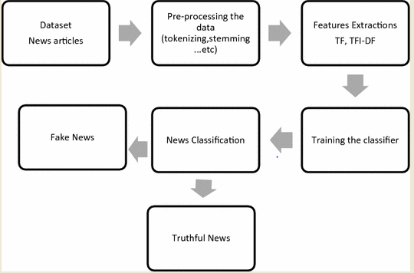
Flowchart

Slide 6

Why it’s better than any existing solution?
As its provides online platform and deals with real time scenarios for checking whether COVID19 news is fake or real, its therefore quite easy to use application.
The spectrum of true-to-fake news will enable us to develop a new type of an auto-detection system capable of more fine-grained judgments
We have currently developed such a solution using Logistic Regression technique in machine learning

Slide 7
References
http://news.mit.edu/2019/better-fact-checking-fake-news-1017
https://www.sciencedaily.com/releases/2018/08/180821112007.htm

Slide 8
THANK YOU

